Slide 1
Microglia Project Progress 07/01/20 Update
Maya Garg

Slide 2
Motivation
Using preexisting scientific sources and GEO single cell RNA-seq data, examine and compare the microglial populations amongst the subgroups of medulloblastoma (SHH, WNT, G3, G4).
In order to compare microglial populations, develop a way to quantify quantify gene expression in cells.
Gene expression quantification may provide a way to determine the maturation stage of the microglia, which will allow for the quantification of subpopulations of microglia
This will allow for the cross comparison of microglial populations between MB subtypes

Slide 3
Methods (To date)
Started by researching (using online databases) about microglia and microglial gene markers
Compiled gene markers and extracted from gene expression matrix in GEO dataset
Selected 3 samples for each subtype of MB
Criteria was as follows:
Total samples available: 36
Of the 36: 25 MB patient samples, 11 patient derived xenograft models
Of the 25 MB patients: 23 diagnostic samples and 2 recurrences
For the sake of maintaining similar conditions across trials: All samples used are diagnostic MB patient samples
Generated clustered heat maps for each sample

Slide 4
Gene Markers
Sparc¹ → SPARC is a matricellular protein that modulates the activity of growth factors, cytokines, and ECM to assist in tissue development and repair. SPARC is highly localized in mature ramified microglia²
Iba 1¹ (expressed in microglia and macrophages)→ Microglial cells are the only brain cells to express Iba-1, expression is up-regulated in activated microglia enabling differentiation between cells engaged in routine surveillance and those which are activated in response to injury³
CD11b⁴ (Expressed in both microglia and macrophages)→ increased expression of CD11b, the β-integrin marker of microglia, represents microglial activation during neurodegenerative inflammation.⁵
P2ry12⁴ (specific microglial marker) → expression decreased during microglial activation
TMEM119⁴ (specific microglia marker) → transmembrane protein 119 (Tmem119), a cell-surface protein of unknown function, as a highly expressed microglia-specific marker in both mouse and human.⁶
CD45⁴ → microglia express this gene as a response to neuroinflammation
Slc2a5^{4 →} Solute Carrier Family 2 Member 5⁷. Recognized as a top differentially expressed gene (DEG). It emerged amongst the best DEGs for identifying peripheral monocytes/macrophages.⁸
Sall 1^{4 → “}Gene expression profiling has identified Sall1, which encodes a transcriptional regulator, as a microglial signature gene. We found that Sall1 was expressed by microglia but not by other members of the mononuclear phagocyte system or by other CNS-resident cells.”⁹
1. https://www.hindawi.com/journals/sci/2018/9628289/
2. Lloyd-Burton SM, York EM, Anwar MA, Vincent AJ, Roskams AJ. SPARC regulates microgliosis and functional recovery following cortical ischemia. J Neurosci. 2013;33(10):4468-4481. doi:10.1523/JNEUROSCI.3585-12.2013
3. “Anti-Iba1 Microglia Marker.” Alpha Laboratories.
4. DePaula-Silva, A., Gorbea, C., Doty, D.J. et al. Differential transcriptional profiles identify microglial- and macrophage-specific gene markers expressed during virus-induced neuroinflammation. J Neuroinflammation 16, 152 (2019). https://doi.org/10.1186/s12974-019-1545-x
5. Roy, Avik et al. “Up-regulation of microglial CD11b expression by nitric oxide.” The Journal of biological chemistry vol. 281,21 (2006): 14971-80. doi:10.1074/jbc.M600236200.
6. Bennett, Mariko L., et al. “New Tools for Studying Microglia in the Mouse and Human CNS.” PNAS, National Academy of Sciences, 22 Mar. 2016, www.pnas.org/content/113/12/E1738.
7. https://www.genecards.org/cgi-bin/carddisp.pl?gene=SLC2A5
8. Haage, V., Semtner, M., Vidal, R.O. et al. Comprehensive gene expression meta-analysis identifies signature genes that distinguish microglia from peripheral monocytes/macrophages in health and glioma. acta neuropathol commun 7, 20 (2019).
9. Buttgereit A, Lelios I, Yu X, et al. Sall1 is a transcriptional regulator defining microglia identity and function [published correction appears in Nat Immunol. 2017 Jan 19;18(2):246]. Nat Immunol. 2016;17(12):1397-1406. doi:10.1038/ni.3585
4

Slide 5
Gene Markers Cont.
Microglia cell surface enriched genes
Gene symbol | Gene name
Ecscr | Endothelial cell surface expressed chemotaxis and apoptosis regulator
Scamp5 | Secretory carrier membrane protein 5
Ptprm | Protein tyrosine phosphatase, receptor type M
Kcnd1 | Potassium voltage-gated channel subfamily D, member 1
Sdk1 | Sidekick cell adhesion molecule 1
Clstn1 | Calsyntenin-1
Sgce | Sarcoglycan epsilon
Slc12a2 | Solute carrier family 12, member 2
Cadm1 | Cell adhesion molecule 1
Sema4g | Semaphorin 4G
Pros1 | Protein S
Slco2b1 | Solute carrier organic anion transporter family, member 2b1
Rtn4rl1 | Reticulon 4 Receptor Like 1
Cmtm4 | CKLF-like MARVEL transmembrane domain-containing protein 4
Fat3 | Fat atypical cadherin 3
Smo | Smoothened homolog
Mrc2 | Mannose receptor C type 2
Jam2 | Junctional adhesion molecule 2
Plxna4 | Plexin A4
Slc46a1 | Solute carrier family 46, member 1
Agmo | Alkylglycerol monooxygenase (Tmem195)
Gpr165 | G protein-coupled receptor 165
Tmem204 | Transmembrane Protein 204
P2ry12 | P2Y purinoceptor 12
Cell Surface Localization of microglia ⁴- specific gene products
→ meaning these are common genes which code for proteins found on the microglial cell surface in response to neuroinflammation
4. DePaula-Silva, A., Gorbea, C., Doty, D.J. et al. Differential transcriptional profiles identify microglial- and macrophage-specific gene markers expressed during virus-induced neuroinflammation. J Neuroinflammation 16, 152 (2019). https://doi.org/10.1186/s12974-019-1545-x
5

Slide 6
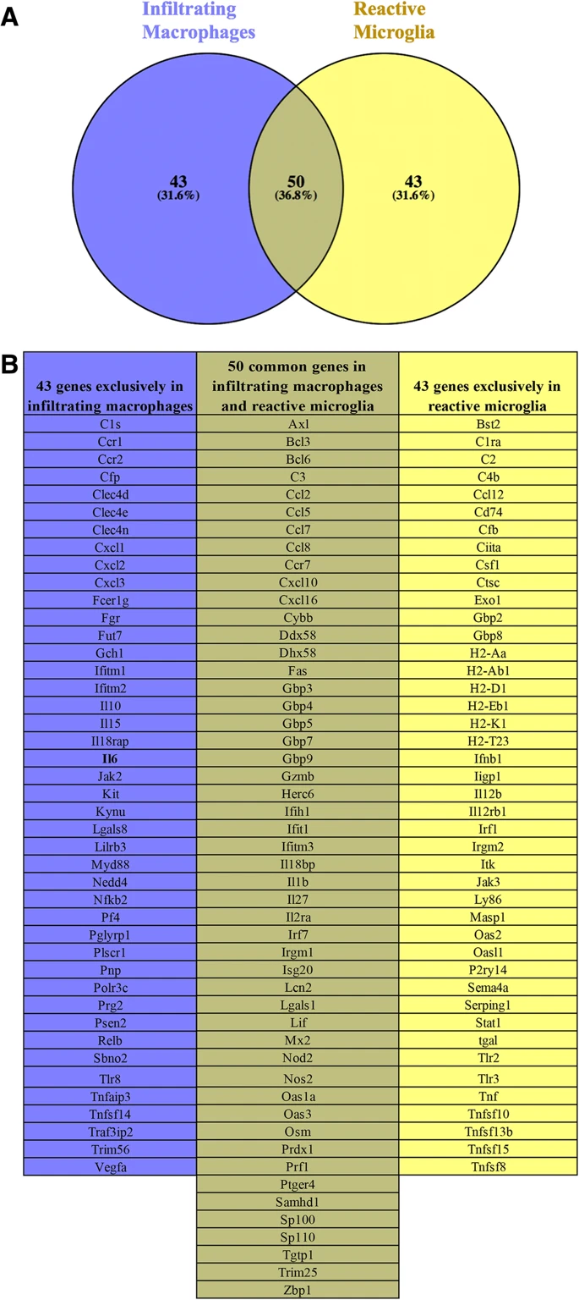
Gene Markers Cont.
Functional differences and similarities in the microglial and macrophage immune response gene profiles during neuroinflammation⁴ “a Venn diagram of the immune response genes in infiltrating macrophages and reactive microglia that were identified in Fig. 7. Overlapping circles represent genes that are upregulated in both infiltrating macrophages and reactive microglia. b List of genes from the Venn diagram that are exclusively expressed by infiltrating macrophages (blue column), microglia (light yellow column), and by both cell populations (dark yellow column).”⁴
4. DePaula-Silva, A., Gorbea, C., Doty, D.J. et al. Differential transcriptional profiles identify microglial- and macrophage-specific gene markers expressed during virus-induced neuroinflammation. J Neuroinflammation 16, 152 (2019). https://doi.org/10.1186/s12974-019-1545-x

Slide 7
Gene Markers Cont.
Immunohistochemical markers for monocyte/macrophage lineage⁷:
Ki-M1P → Marker for macrophages, microglia, epithelioid cells, plasmocytic T cells
HLA-DR → Marker for monocytes, macrophages and activated microglia and others
EBM 11 → Marker for microglia, macrophages
10. Roggendorf, W., Strupp, S. & Paulus, W. Distribution and characterization of microglia/macrophages in human brain tumors. Acta Neuropathol 92, 288–293 (1996). https://doi.org/10.1007/s004010050520

Slide 8
Comprehensive List of Microglia Marker Genes:
All of the genes in this red color were not tested for/included in the large matrix (data set)
Iba 1
CD11b
CD45
Fcrls → only in mice
Siglech → only in mice
Gpr165
Ki-M1P
HLA-DR
EBM 11
The following genes in black were included in the datasets from https://www.ncbi.nlm.nih.gov/geo/query/acc.cgi?acc=GSE119926 Sparc
P2ry12
TMEM119 ← most widely recognized microglia specific marker
Slc2a5
Sall 1
Ecscr
Scamp5
Ptprm
Kcnd1
Sdk1
Clstn1
Sgce
Slc12a2
Cadm1
Sema4g
Pros1
Slco2b1
Rtn4rl1
Cmtm4
Fat3
Smo
Mrc2
Jam2
Plxna4
Slc46a1
Agmo
Tmem204
CX3CR1
Bst2
C2
C4b
Cd74
Cfb
Ciita
Ctsc
Exo1
Gbp2
Ifnb1
Irf1
Itk
Jak3
Ly86
Masp1
Oas2
P2ry14
Sema4a
Serping1
Stat1
Tlr2
Tlr3
Tnf
Tnfsf10
Tnfsf13b
Tnfsf15
Tnfsf8
C1ra
Ccl12
Csfl
Gbp8
H2-Aa → only in mice
H2-Ab1→ only in mice
H2-D1→ only in mice
H2-Eb1→ only in mice
H2-K1→ only in mice
H2-T23→ only in mice
Iigp1
I112rb1
Irgm2
Oas11
tgal
The genes that were included in the dataset were
Extracted from the matrix as the microglial markers

Slide 9
What the code does
Loads in the GEO data
Extracts the microglial marker genes from the matrix
Normalizes and scales the data
Looks for variable features (These features are a subset of genes that exhibit high cell to cell variation in the data. This means that they are highly expressed in some cells and lowly expressed in others)
Runs PCA on the data (required for the heatmap)
Finds clusters and cell cluster markers
Groups cells by clusters
Produces heatmap accordingly

Slide 10
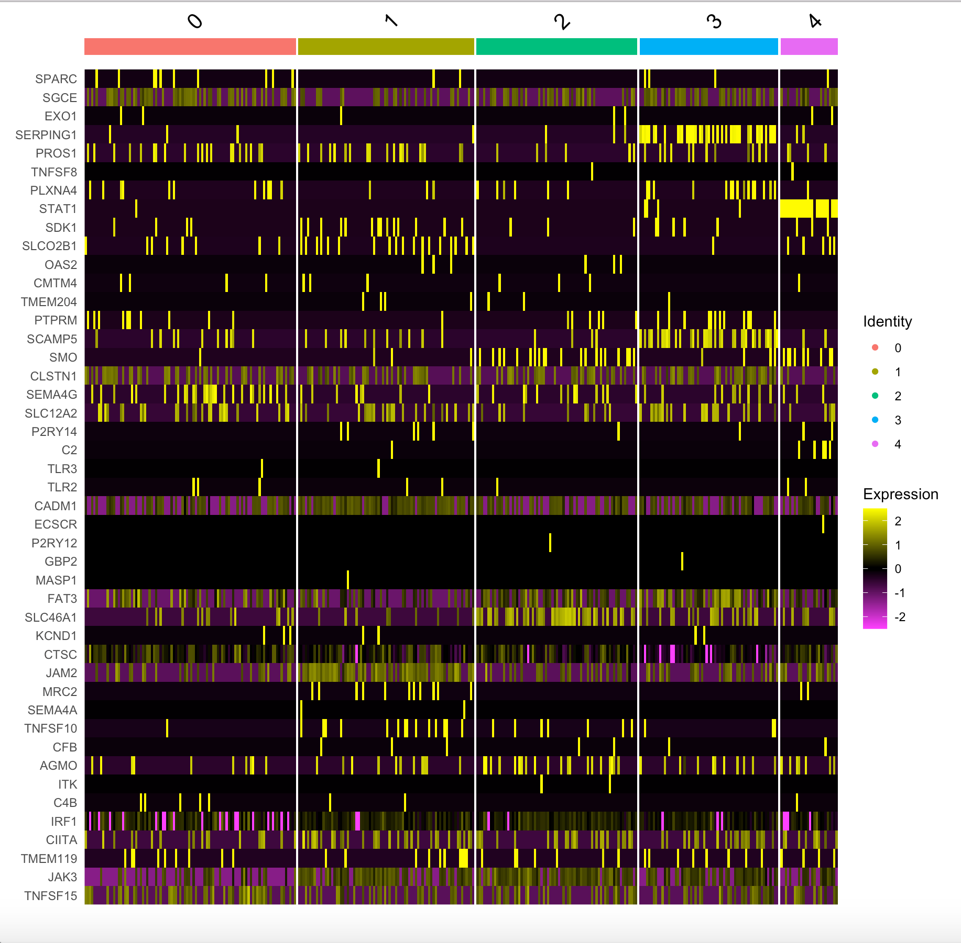
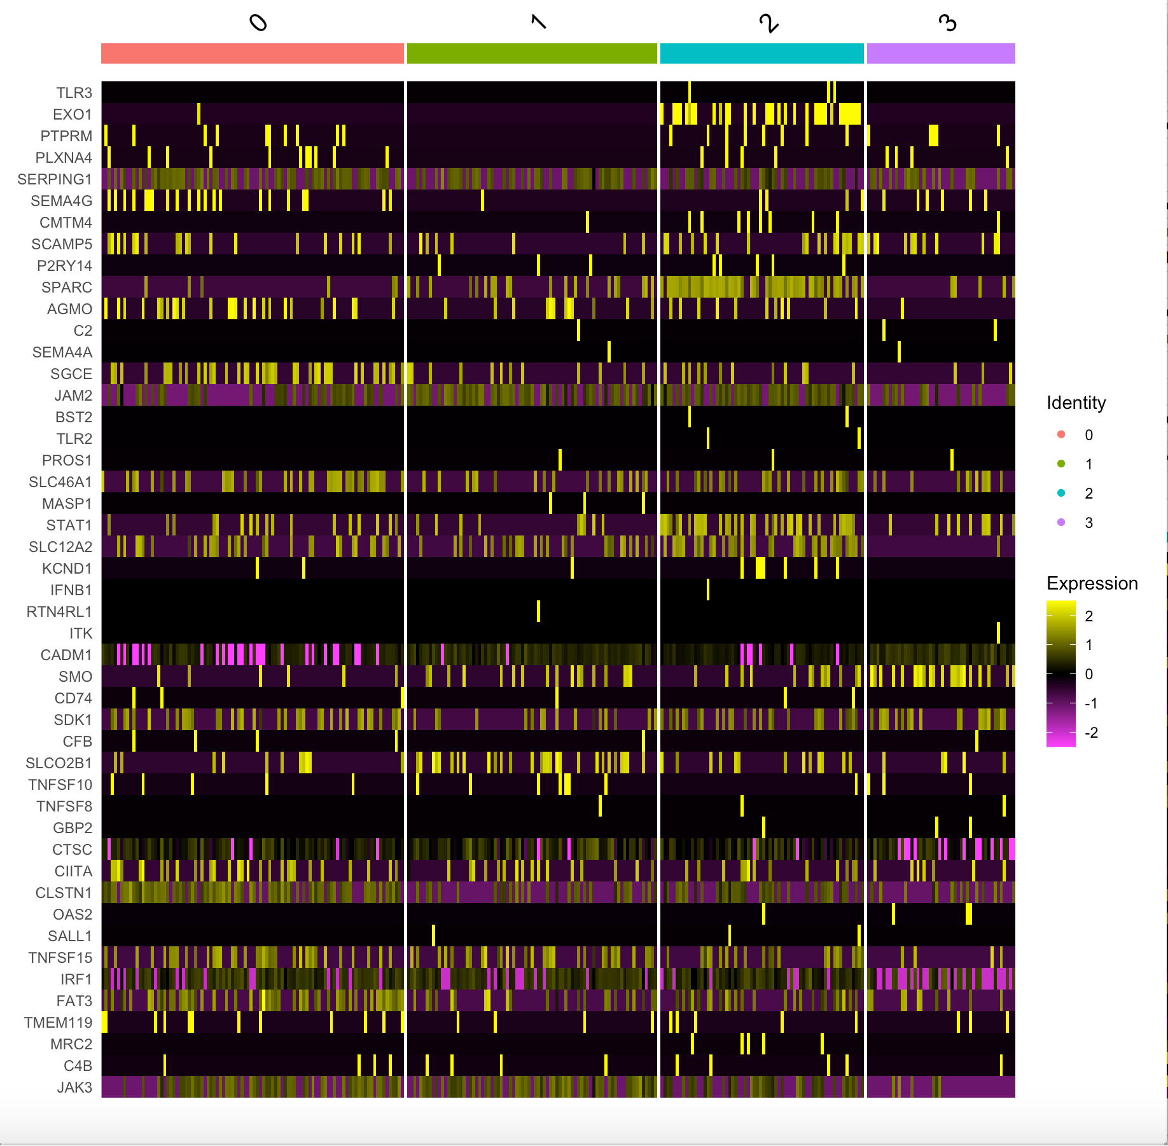
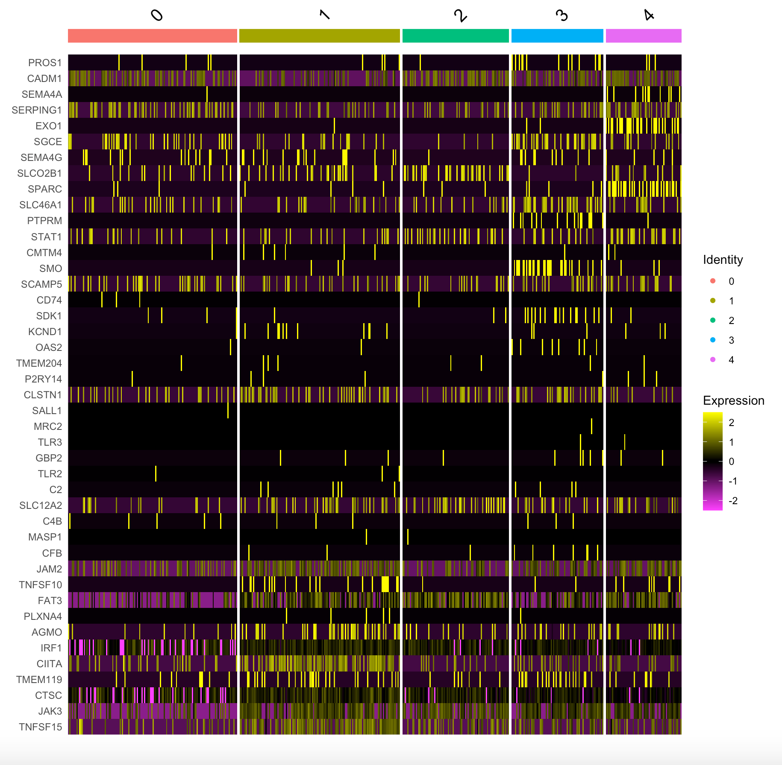
SHH Heatmaps
SHH-infant Male, 4yo | SHH-infant Male, 3yo | SHH-adult Male, 13yo

Slide 11
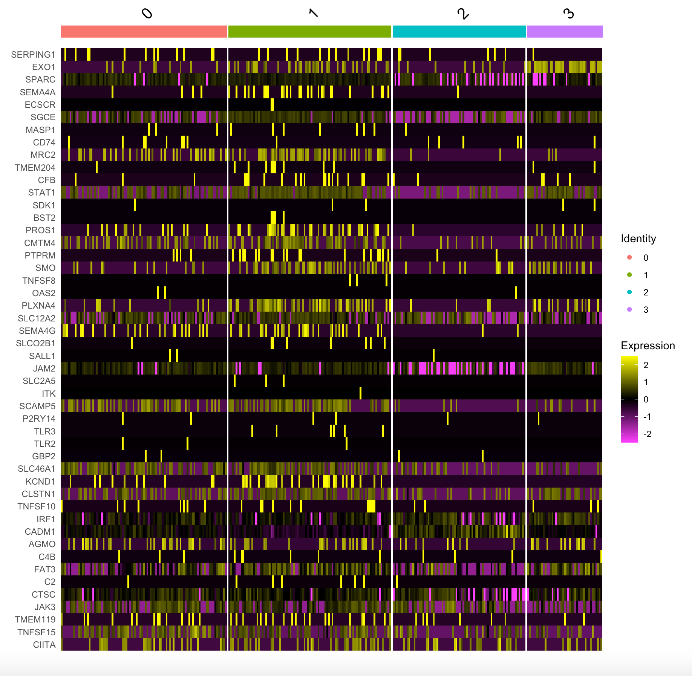
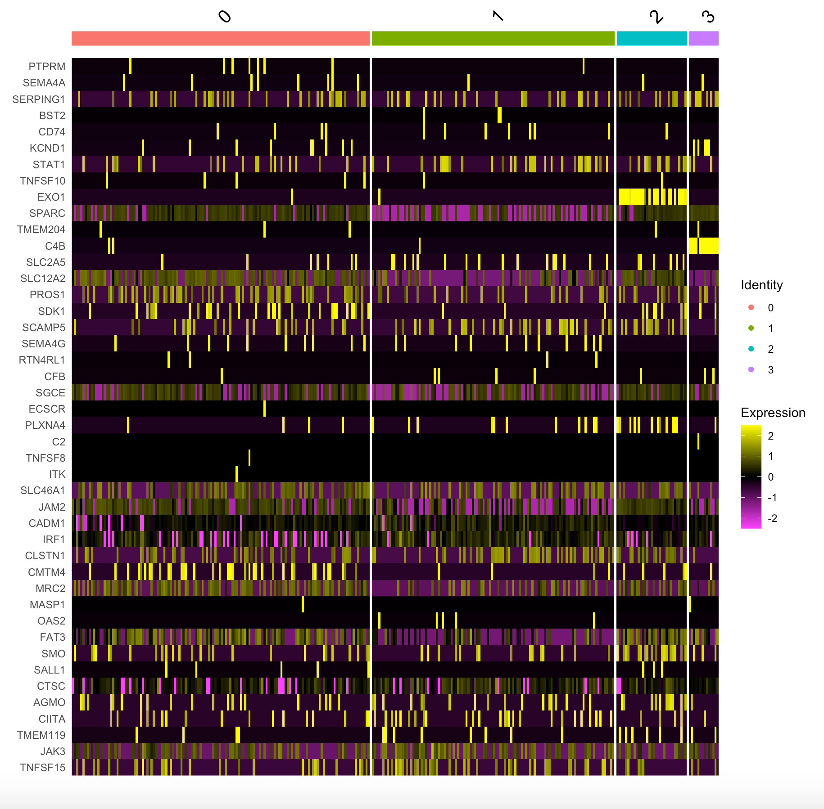
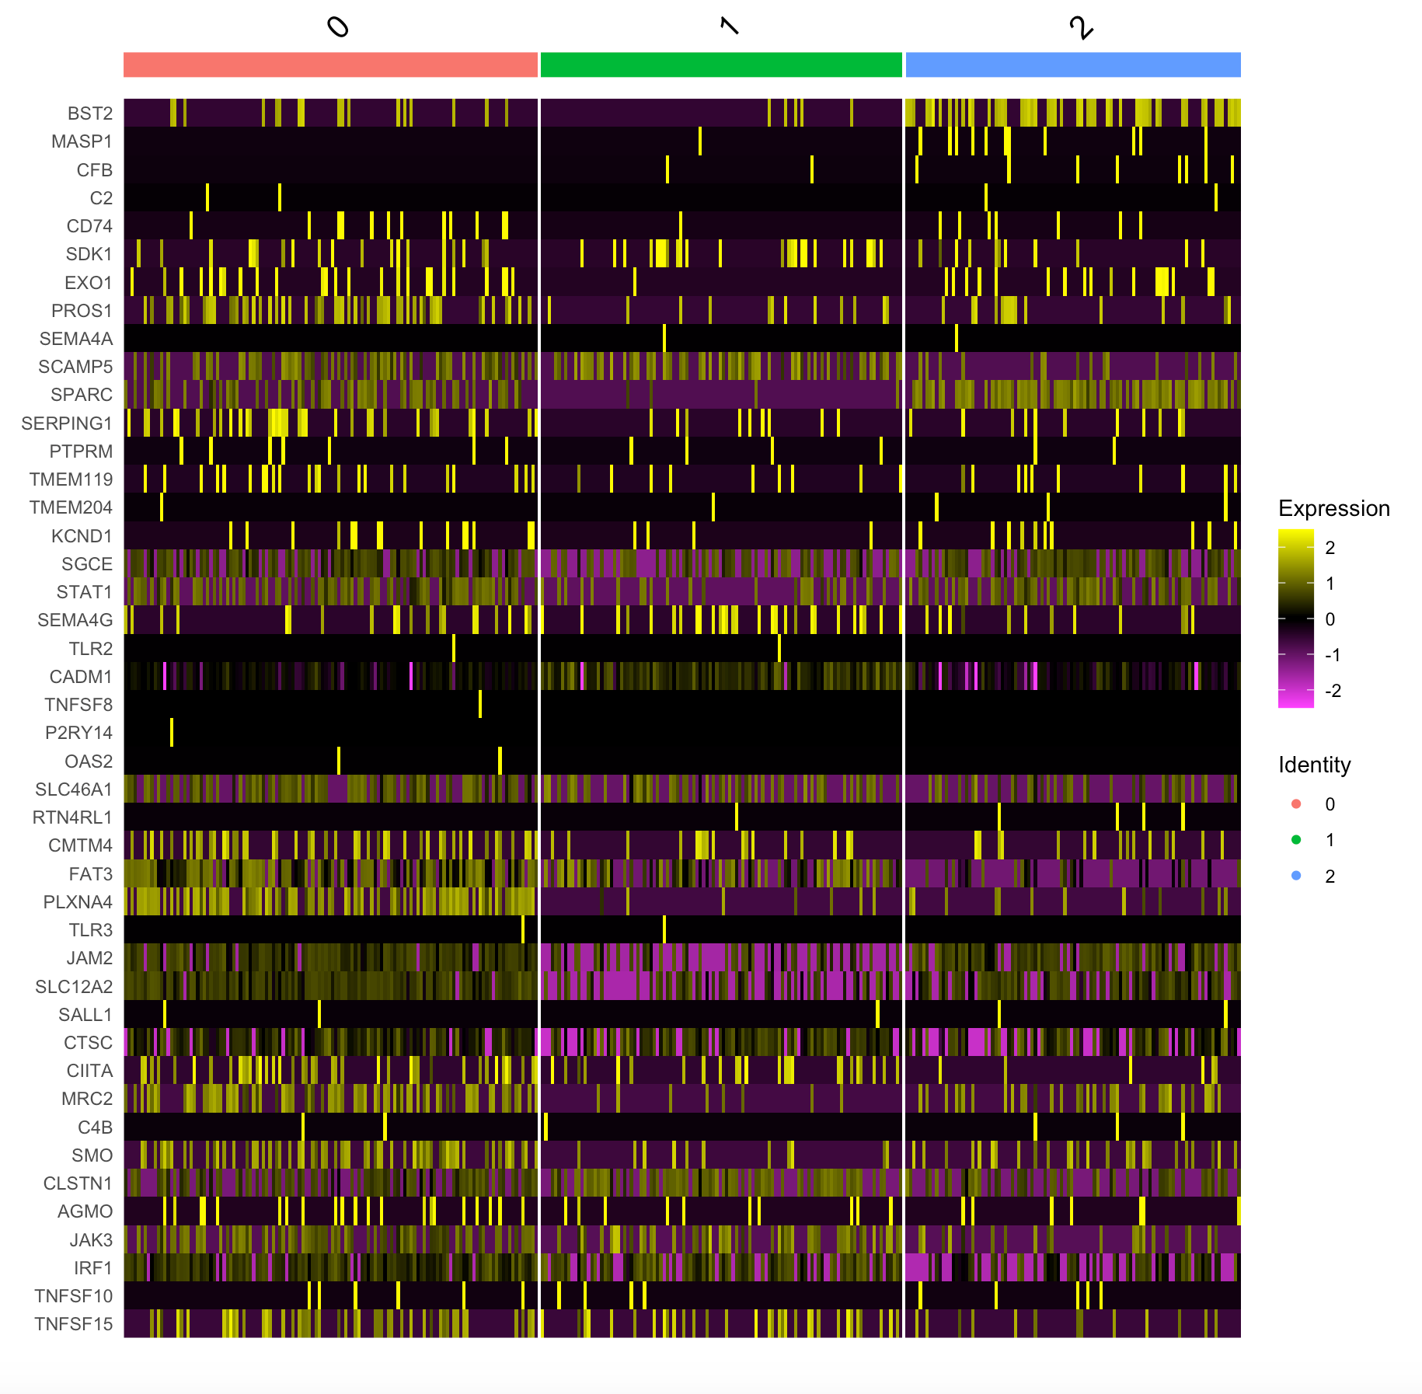
WNT Heatmaps
Male, 12yo | Male, 9yo | Male, 17yo

Slide 12
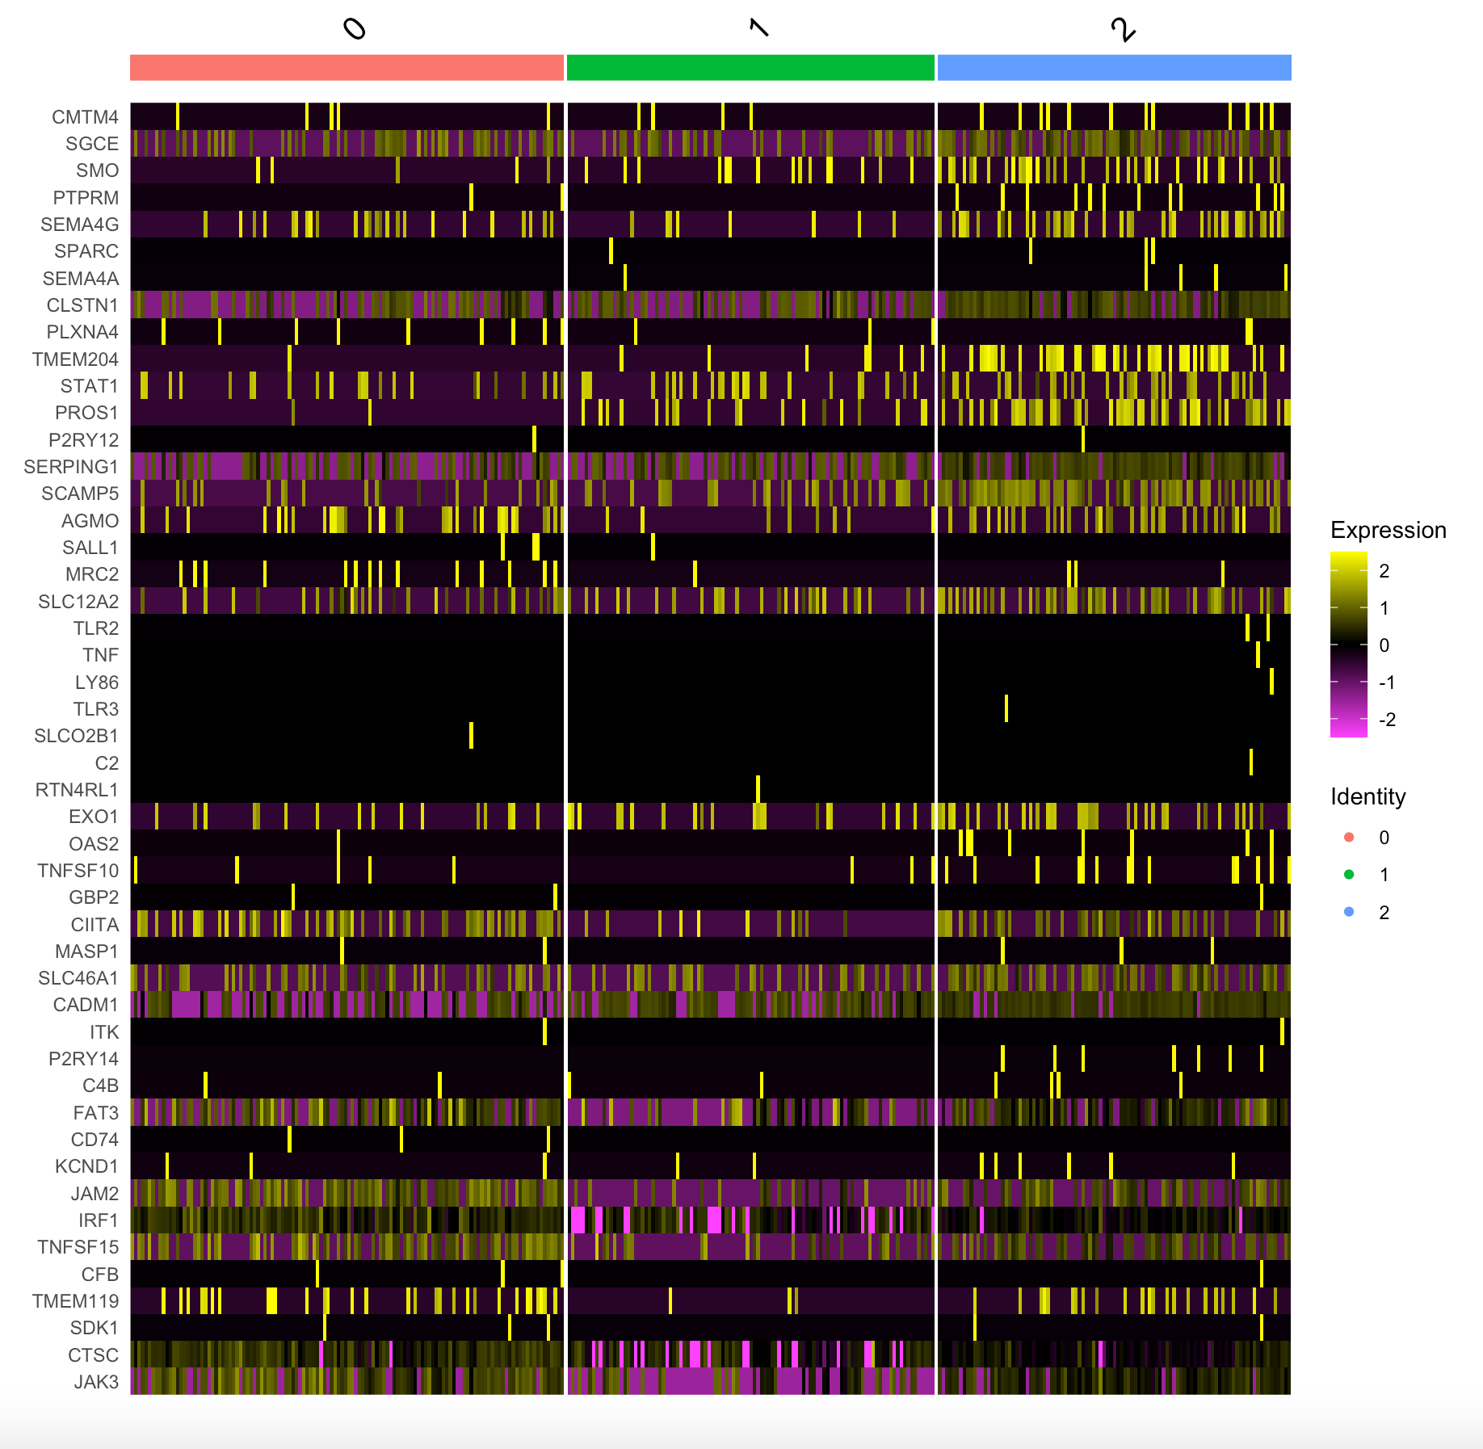
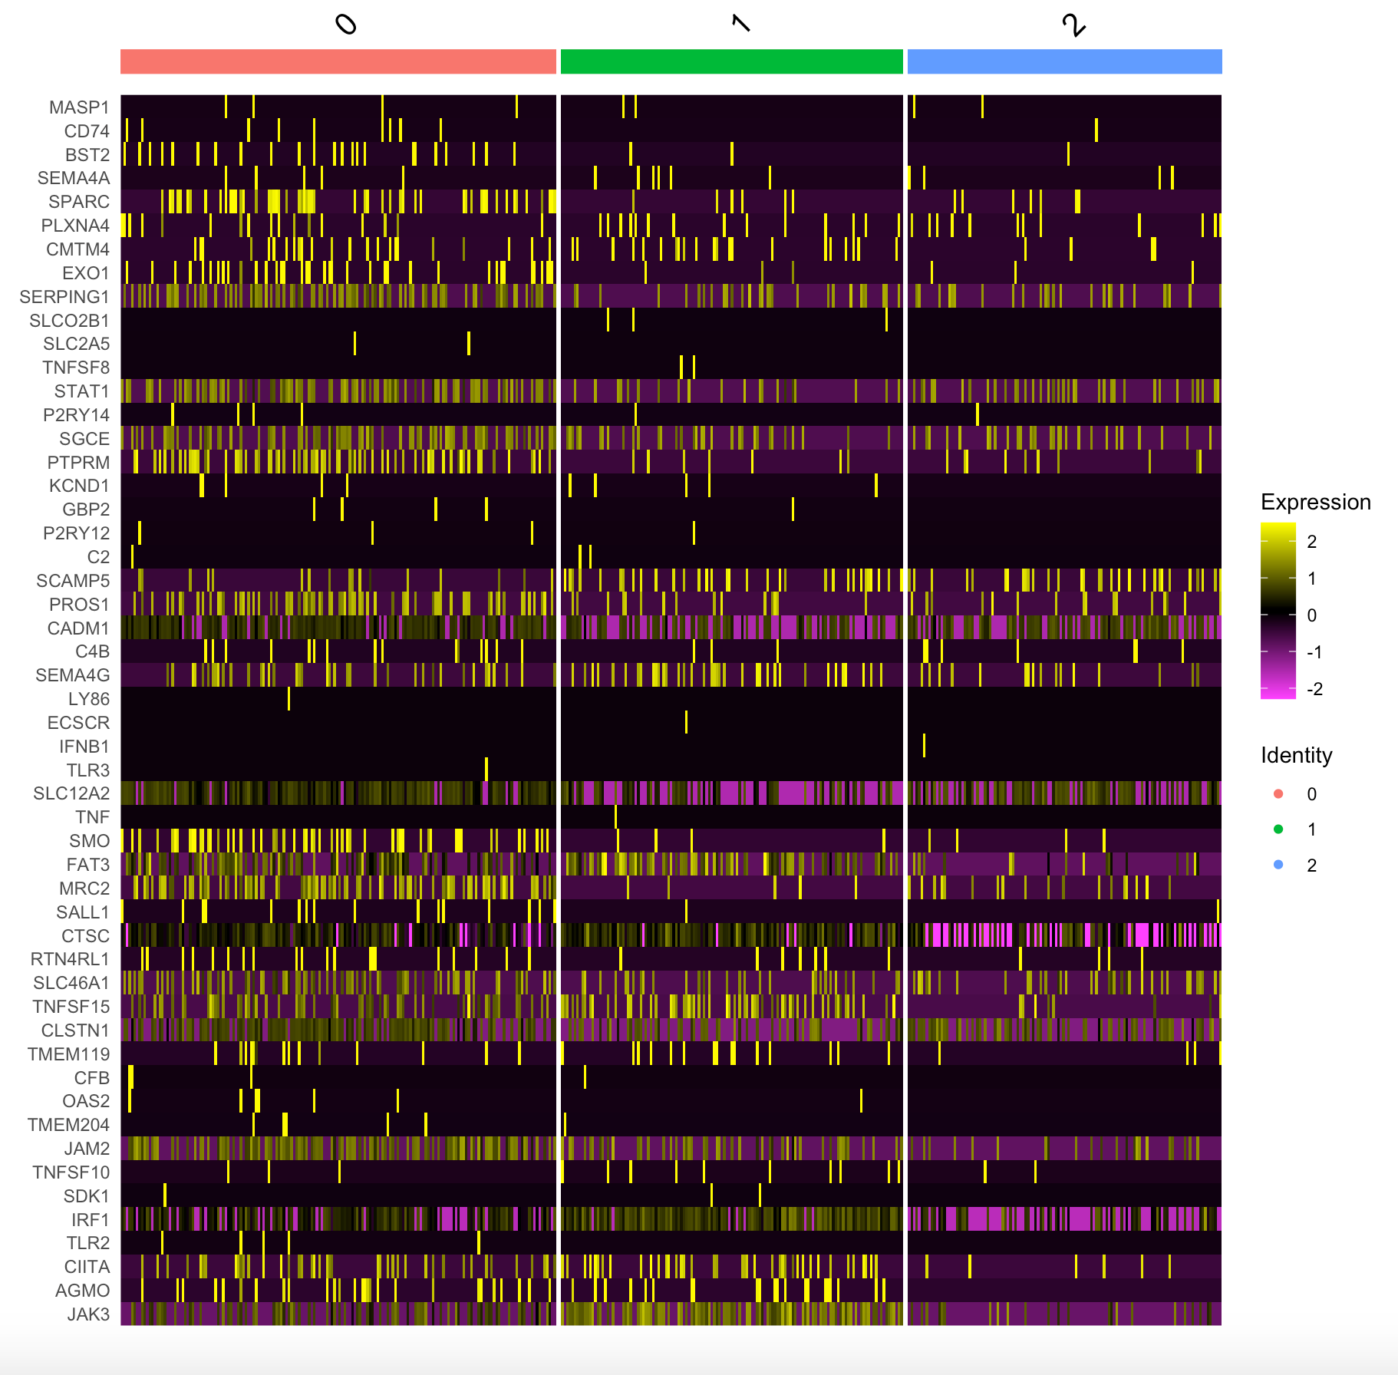
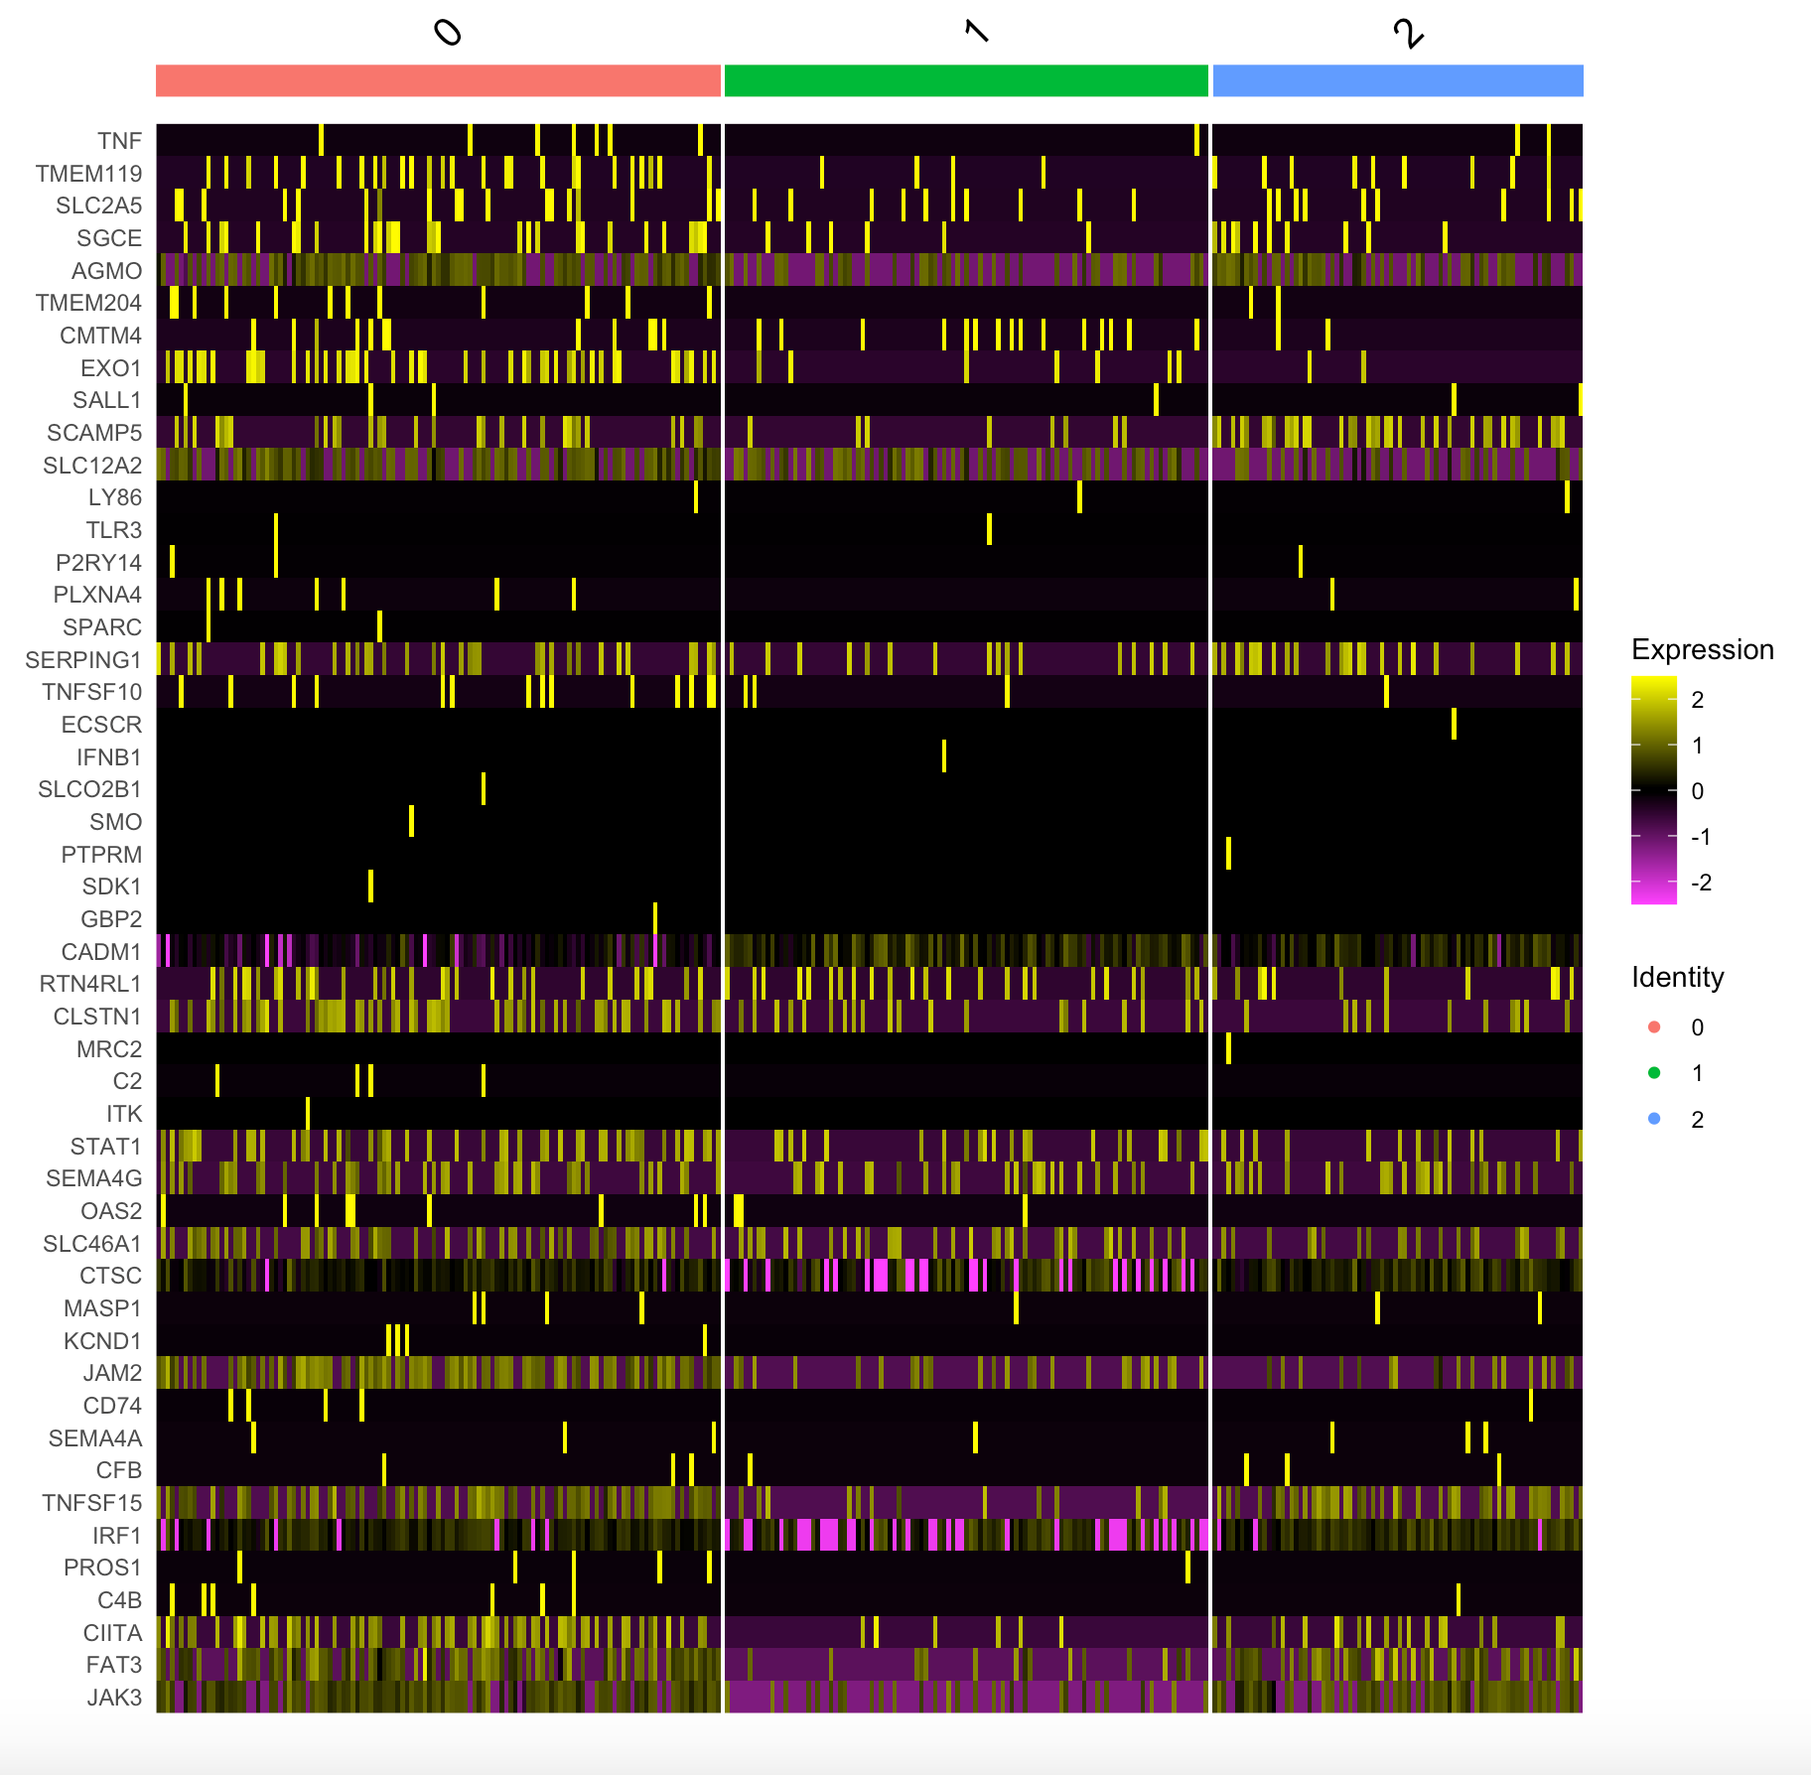
G3 Heatmaps
Methylation subtype V Male, 8yo | Methylation subtype II Male, 6yo | Methylation subtype II Female, 4yo

Slide 13
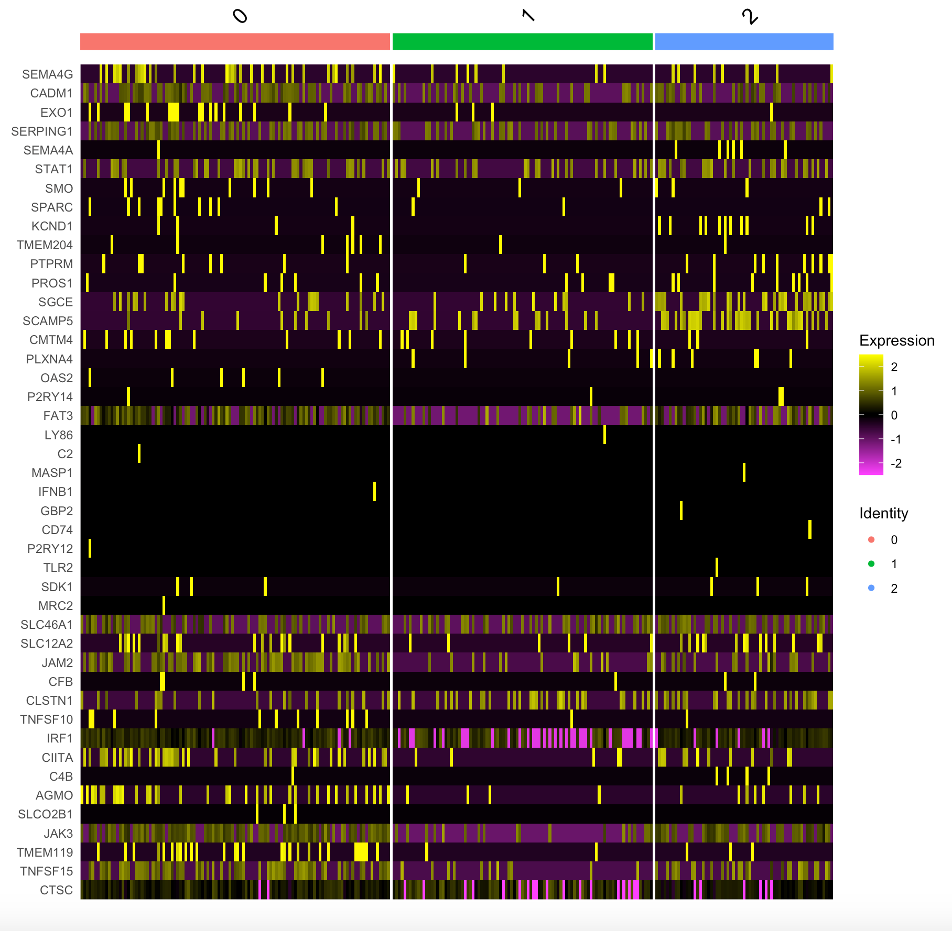
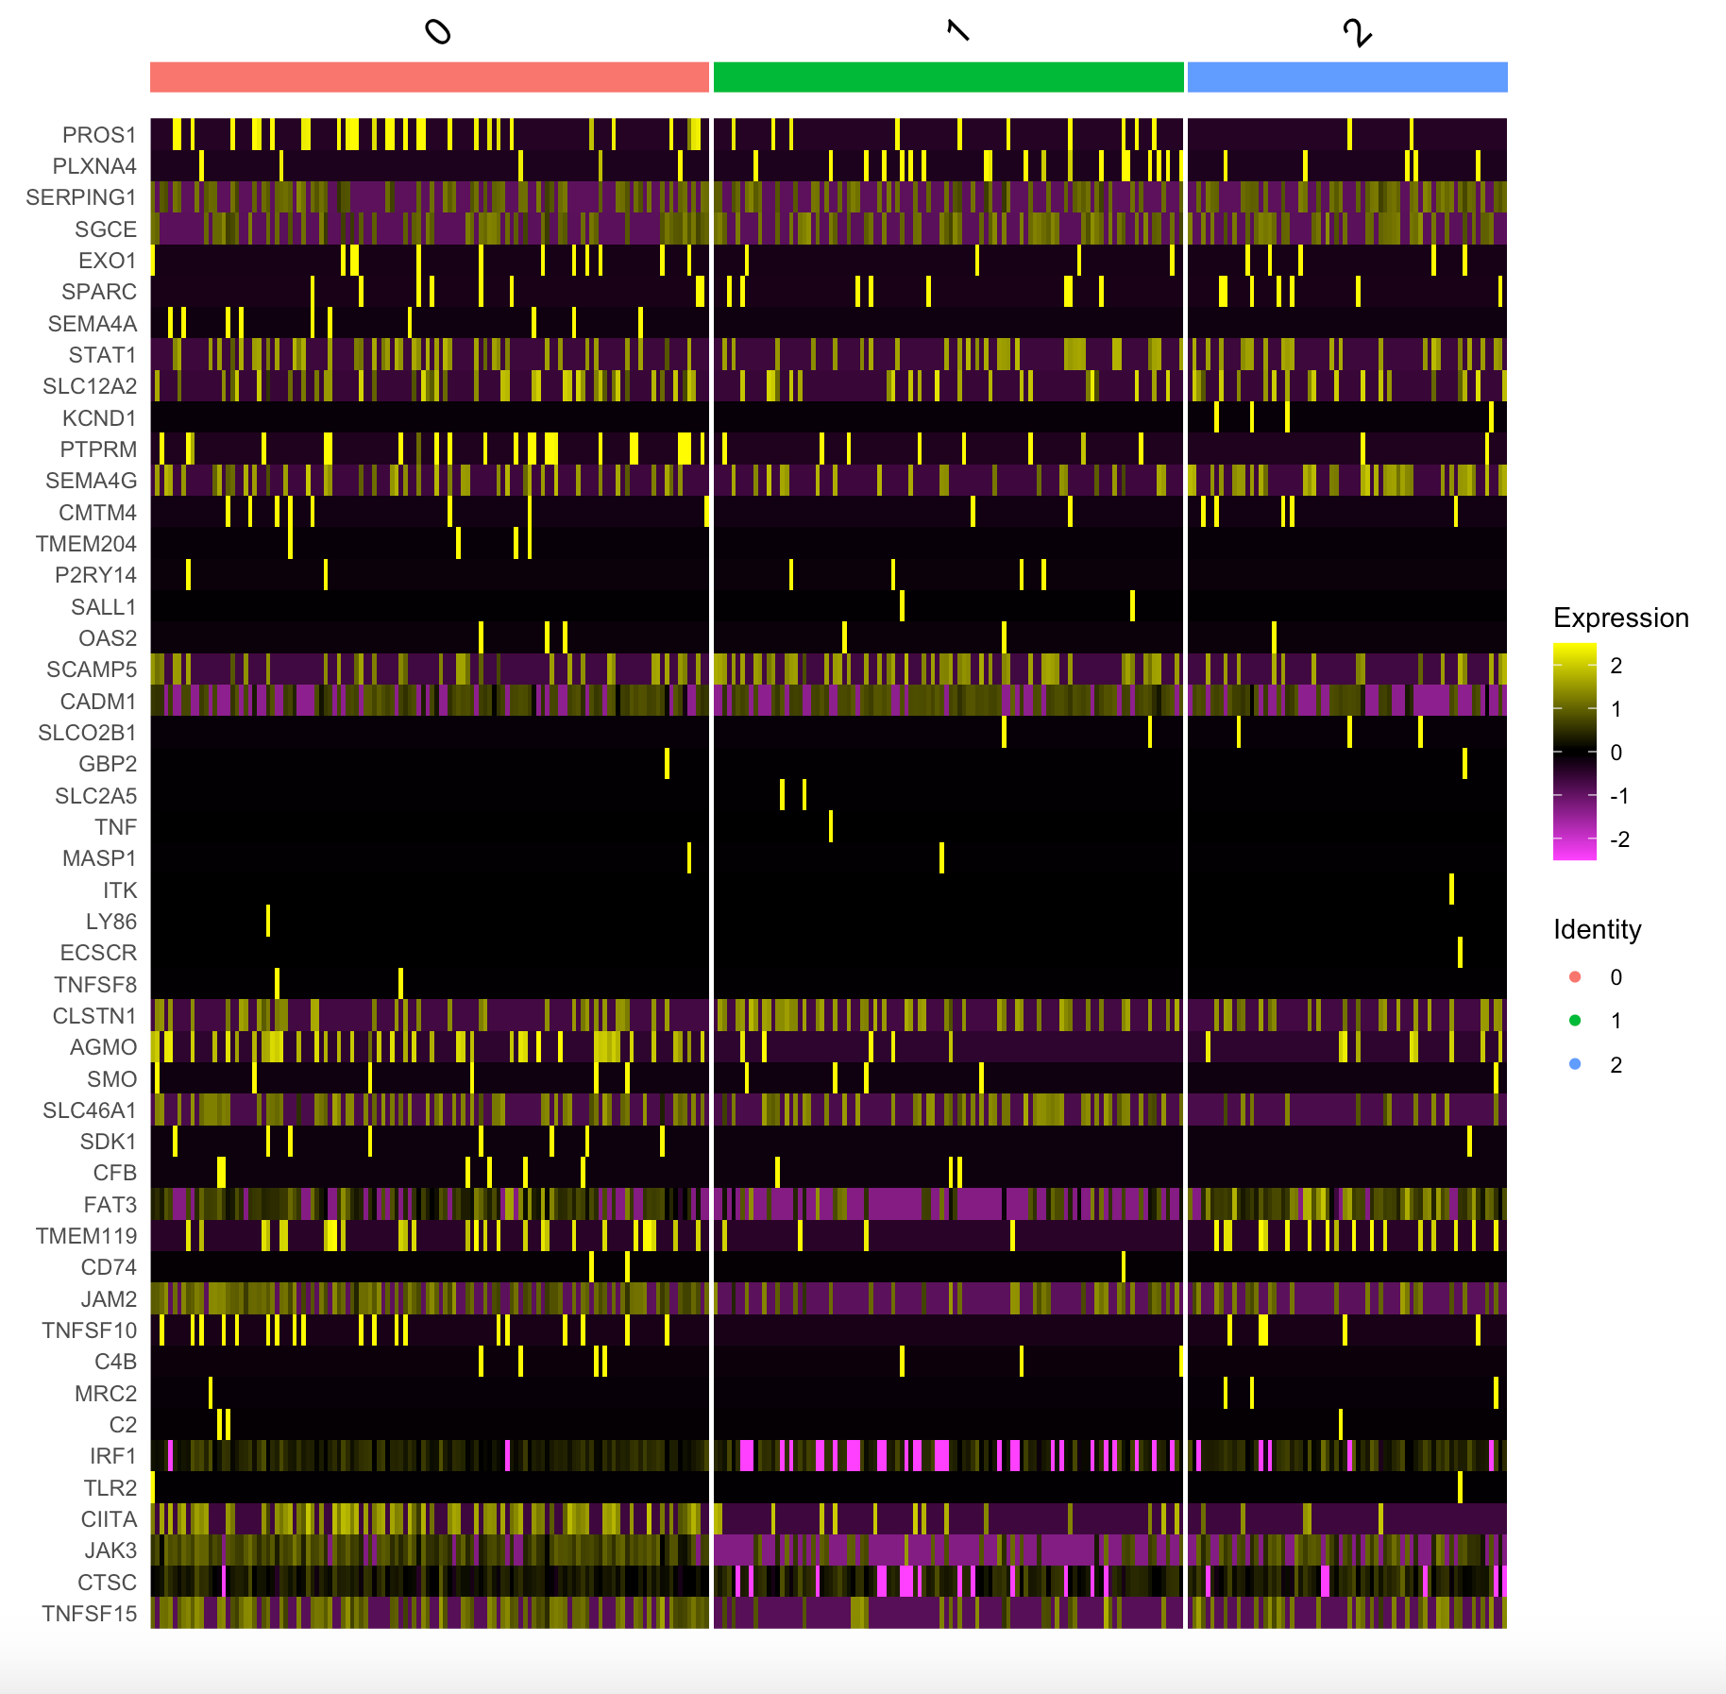
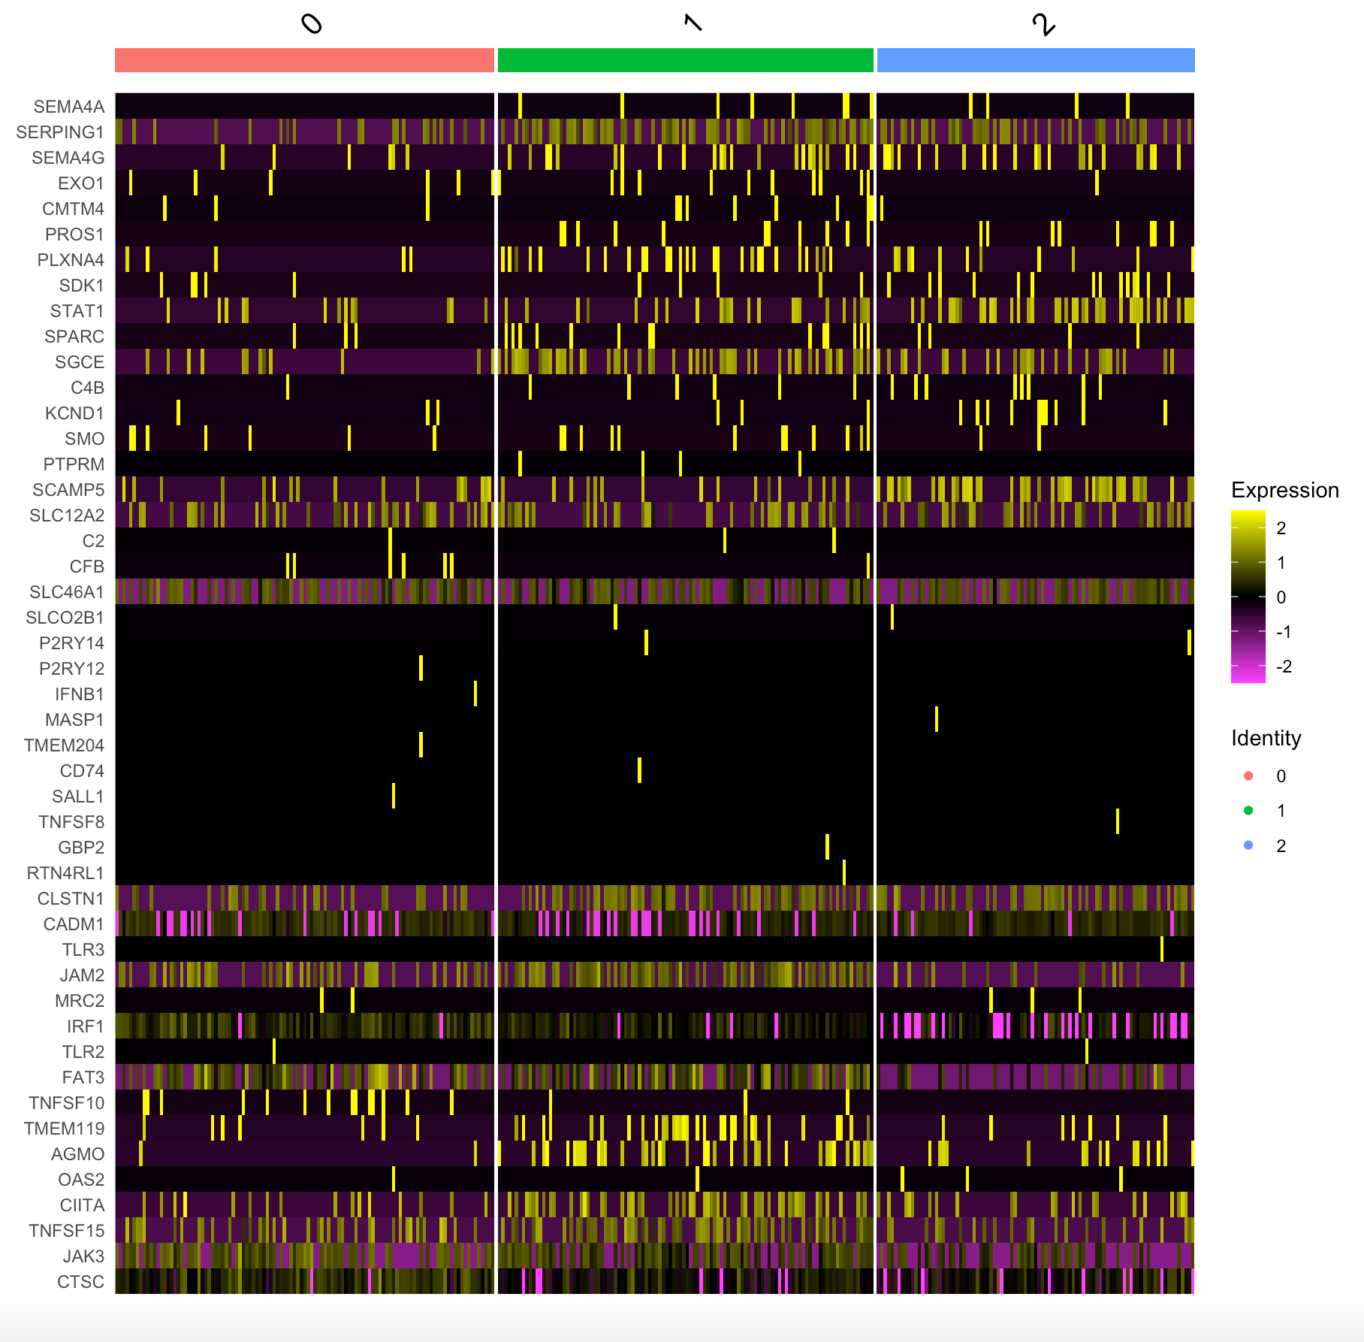
G4 Heatmaps
Methylation subtype VIII Male, 12yo | Methylation subtype VIII Male, 16yo | Methylation subtype VIII Female, 7yo

Slide 14
Next Steps
Now that the heatmaps have been generated, I want to look into which genes can help determine the microglia subpopulations/ macrophages and use that information to sort and label these cell clusters
Following this I want to start figuring out how to quantify the gene expression levels in cells and sorting based on this quantification
Also want to examine differences and similarities in the top expressed genes between and within MB subtypes

Slide 15
Sources
1. https://www.hindawi.com/journals/sci/2018/9628289/
2. Lloyd-Burton SM, York EM, Anwar MA, Vincent AJ, Roskams AJ. SPARC regulates microgliosis and functional recovery following cortical ischemia. J Neurosci. 2013;33(10):4468-4481. doi:10.1523/JNEUROSCI.3585-12.2013
3. “Anti-Iba1 Microglia Marker.” Alpha Laboratories.
4. DePaula-Silva, A., Gorbea, C., Doty, D.J. et al. Differential transcriptional profiles identify microglial- and macrophage-specific gene markers expressed during virus-induced neuroinflammation. J Neuroinflammation 16, 152 (2019). https://doi.org/10.1186/s12974-019-1545-x
5. Roy, Avik et al. “Up-regulation of microglial CD11b expression by nitric oxide.” The Journal of biological chemistry vol. 281,21 (2006): 14971-80. doi:10.1074/jbc.M600236200.
6. Bennett, Mariko L., et al. “New Tools for Studying Microglia in the Mouse and Human CNS.” PNAS, National Academy of Sciences, 22 Mar. 2016, www.pnas.org/content/113/12/E1738.
7. https://www.genecards.org/cgi-bin/carddisp.pl?gene=SLC2A5
8. Haage, V., Semtner, M., Vidal, R.O. et al. Comprehensive gene expression meta-analysis identifies signature genes that distinguish microglia from peripheral monocytes/macrophages in health and glioma. acta neuropathol commun 7, 20 (2019).
9. Buttgereit A, Lelios I, Yu X, et al. Sall1 is a transcriptional regulator defining microglia identity and function [published correction appears in Nat Immunol. 2017 Jan 19;18(2):246]. Nat Immunol. 2016;17(12):1397-1406. doi:10.1038/ni.3585
10. Roggendorf, W., Strupp, S. & Paulus, W. Distribution and characterization of microglia/macrophages in human brain tumors. Acta Neuropathol 92, 288–293 (1996). https://doi.org/10.1007/s004010050520

